Slide 1
MY CASUAL DAY

Slide 2
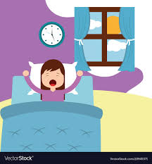
I usually get up at ten to seven a.m. Then I have to wake up my younger sister. I eat my breakfast, brush my hair, dress up, brush my teeth and do other nessary things.

Slide 3
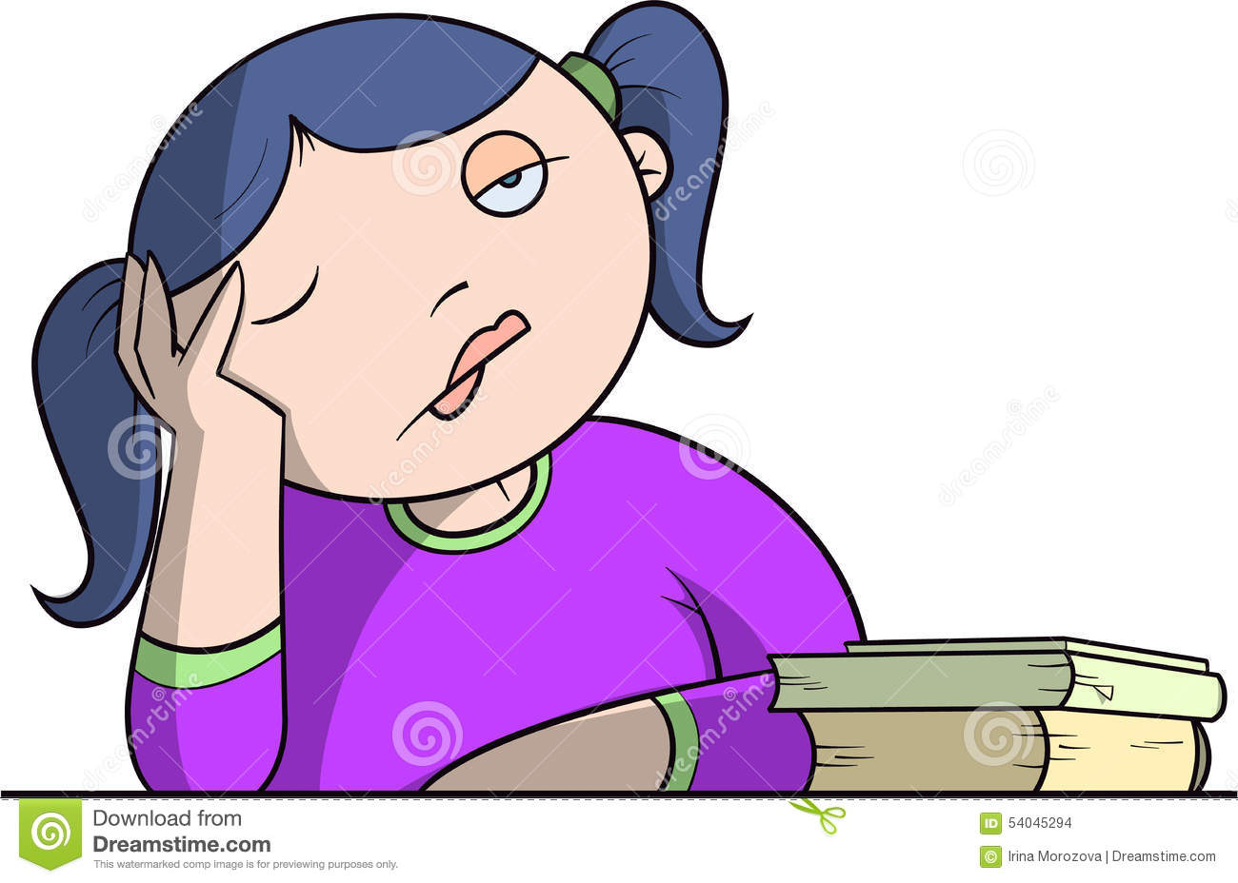
My dad drives me and my sister to school. I start it at eight o’clock and finish at half past twelve or half past one p.m. I usually start my lessons with P.E. I like this subject so I don’t mind it.

Slide 4
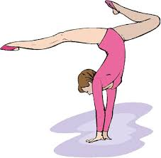
I come back home by tram with my classmate or by myself. Then I do my homework and have some rest. I listen to music, watch TV or play with my gerbils. Sometimes I have extracurricular activities, like acrobatic, but I usually stretch or dance alone at my home.

Slide 5
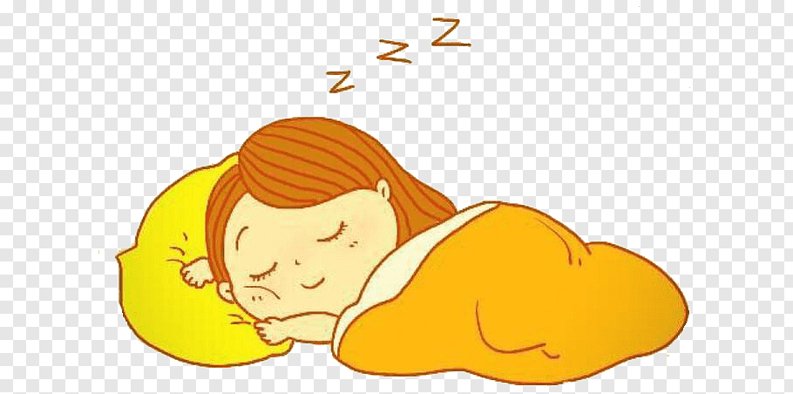
I usually go to bed at about ten p.m. I always read a book before sleep and of course set my alarm on.

